Slide 1
Automated provisioning of SQL Server VMs on Azure
An PowerShell approach from Visual Studio Code
Kay Sauter
Senior Business Intelligence Consultant
OneDigit AG, Switzerland
Notes:
Hi everybody, while I am presenting this session, I am also chatting with you LIVE, so I’ll be answering your questions via text-chat!

Slide 2

Kay Sauter (He/Him)
Senior BI Consultant @ OneDigit AG
SQL Server, PBIRS, SSAS and Azure
Working with data since 2008
Data TGIF founder & organizer
From Zurich, Switzerland
Notes:
Work for OneDigit onedigit.ch
Work with data for more than 12 years
Mostly SQL Server, but also SSAS and Azure
I am using Cochlear Implants to hear you
More info about CI on my Github page github.com/kaysauter/CochlearImplant

Slide 3



Goals 🎯
Create a VM on Azure with PowerShell
Secure connection to VM via TSL/SSL
Install SW on VM via PowerShell
Insights into Pricing 💶
Notes:
Other options like Chef, Ansible etc. are not from Microsoft
This solution focuses on rather simple deployments for few VMs

Slide 4
Agenda
Why 🤔
Architecture 🏛
Security 🔐
Code 👨‍💻
Demo 🎬
Pricing 💶

Slide 5
Why 🤔

Slide 6

Why automate VM deployments?
Always have same setup easily 👉 Reusability
VM can be deleted if needed with no regrets
Testing
Showcasing (eg. with Azure Labs)
A way to save costs
Notes:
Use case OneDigit -> Everyone can do it

Slide 7
Why PowerShell and not…?
PowerShell is a native tool provided by Microsoft
PowerShell: many DBAs already use it
Other possiblity: ARM (Azure Resource Manager), example follows
Bicep 💪 also by Microsoft, but an own language
Ideal for smaller scaled use cases
Notes:
Use case OneDigit -> Everyone can do it
Other options like Chef, Ansible etc. are not from Microsoft
This solution focuses on rather simple deployments for few VMs

Slide 8
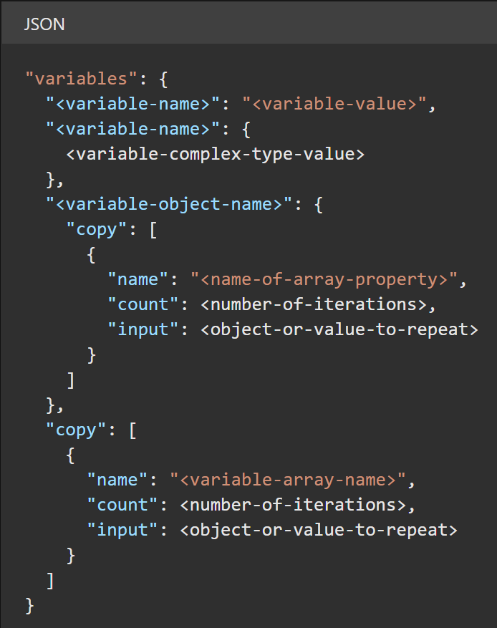
Why PowerShell and not…?
Example of ARM 👉
Gets convoluted quickly
Code is an introductory example by Microsoft
Source:
docs.microsoft.com/en-us/azure/azure-resource-manager/templates/syntax

Slide 9
Architecture 🏗

Slide 10
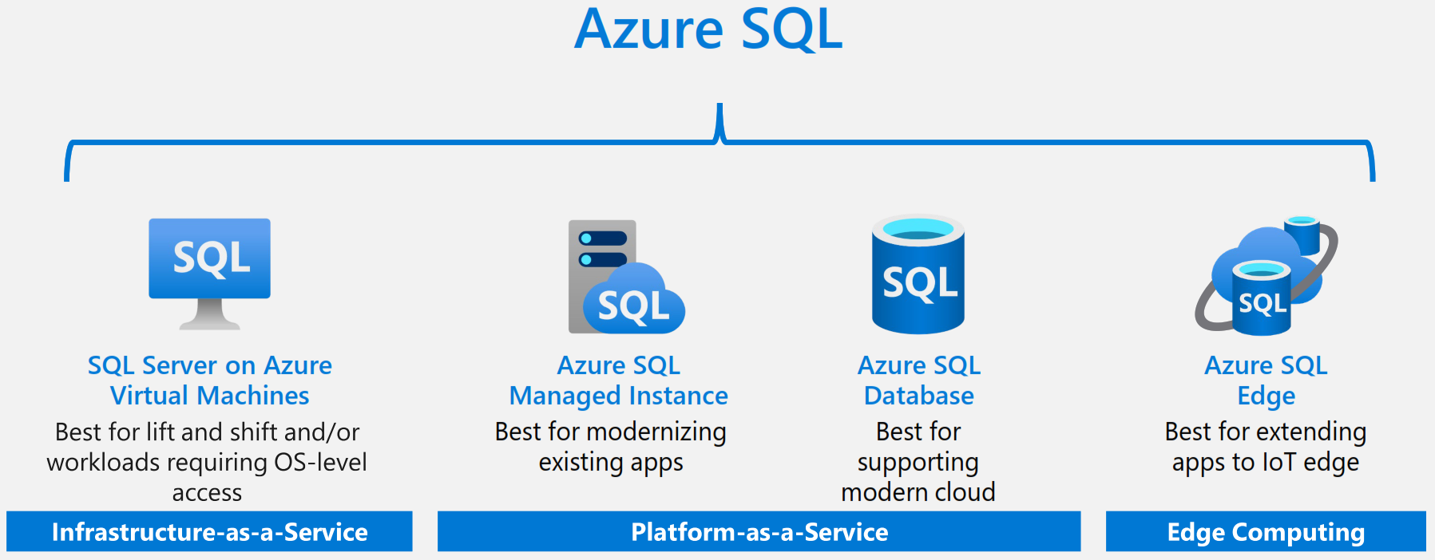
Overview on Azure Platform
Notes:
Source: azure.microsoft.com/en-us/resources/get-to-know-azure-sql/

Slide 11
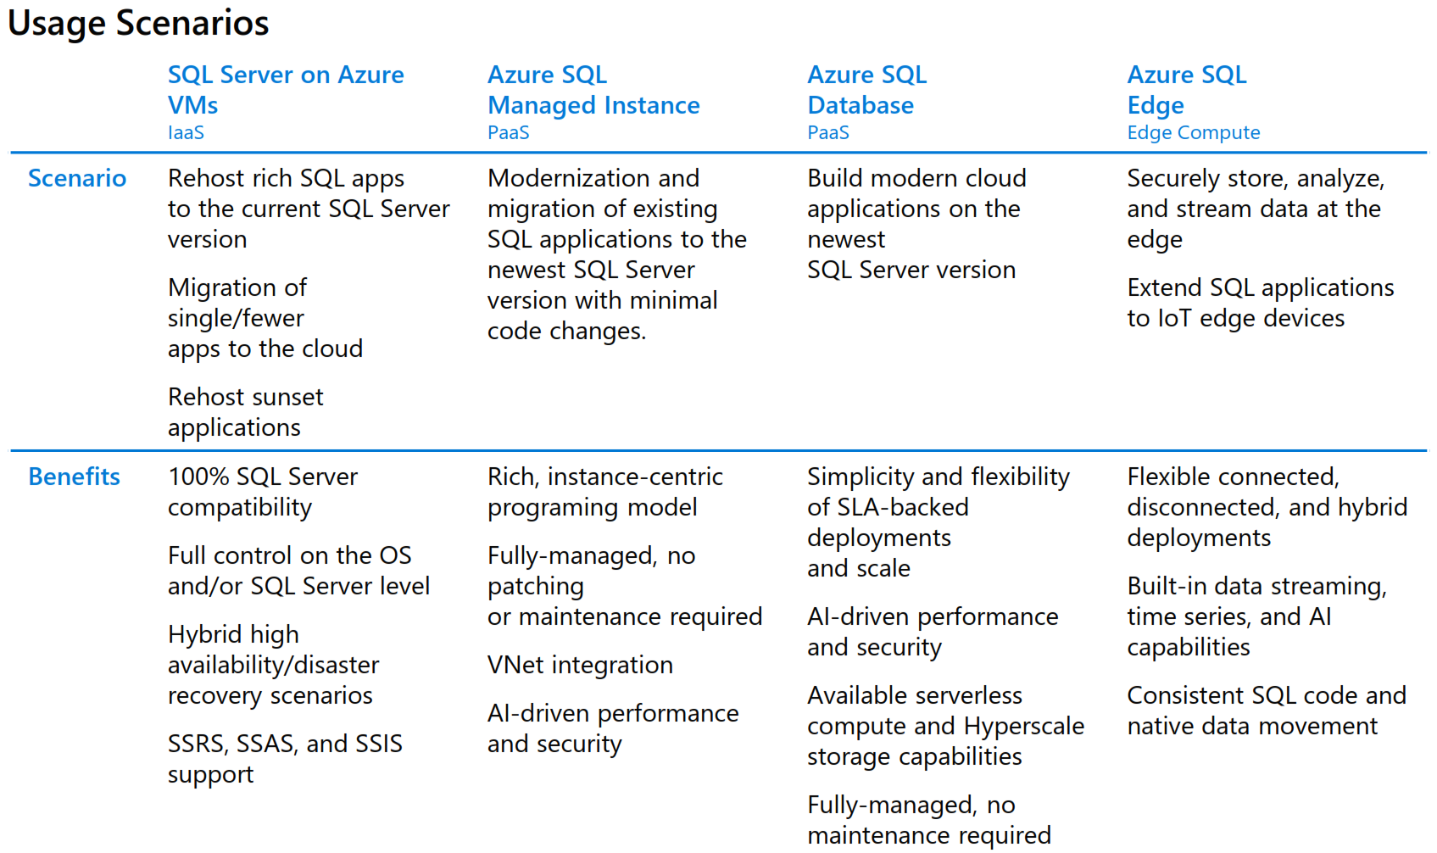
Overview on Azure Platform
Source: azure.microsoft.com/en-us/resources/get-to-know-azure-sql/
Notes:
Because you have full control on VMs, compliance with regulatory reasons can be easier
Still ideal for complex data warehouses
For swiss banking and finance industry, often preferred because for full datawarehouse solutions, still most capabilities
Source: azure.microsoft.com/en-us/resources/get-to-know-azure-sql/

Slide 12
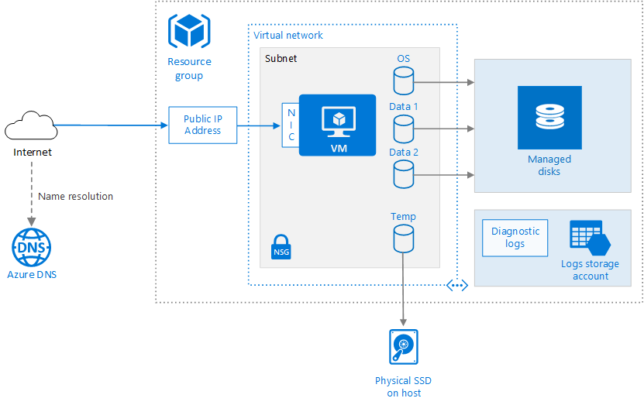
Base Architecture for VM
Source:
docs.microsoft.com/en-us/azure/architecture/reference-architectures/n-tier/windows-vm
Notes:
Base Architecture for VM, will you a few times more so you don’t have to remember everything.
Important: Resource Group which is basically a grouping mechanism to apply everything in it, eg. to move into a different region
Source: docs.microsoft.com/en-us/azure/architecture/reference-architectures/n-tier/windows-vm

Slide 13

How to bring your backups into VM?
Backup files uploaded with Azure File Storage Explorer
Drag & Drop
azure.microsoft.com/en-us/features/storage-explorer/
Azure File Storage will be mapped on VM as Z:\ with PowerShell
Notes:
Question: How do we get our databases into VM?
We are going to restore databases from Azure File Store
Files can be uploaded by Azure Data Store Explorer via Drag & Drop
Like I’ve said, we will attach the Azure File Store to the VM as Z:
Link: azure.microsoft.com/en-us/features/storage-explorer/

Slide 14
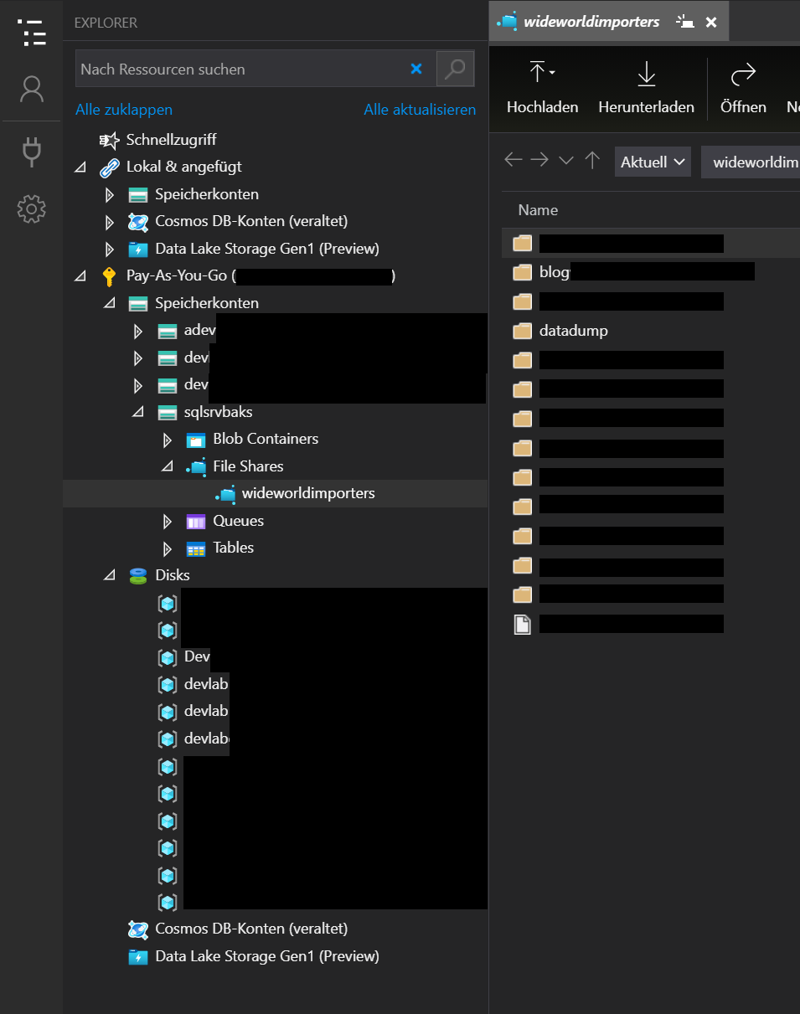

Azure Storage Explorer
Drag & Drop
AdventureWorks.bak
Notes:
Question: How do we get our databases into VM?
We are going to restore databases from Azure File Store
Files can be uploaded by Azure Data Store Explorer via Drag & Drop
Like I’ve said, we will attach the Azure File Store to the VM as Z:
Link: azure.microsoft.com/en-us/features/storage-explorer/

Slide 15
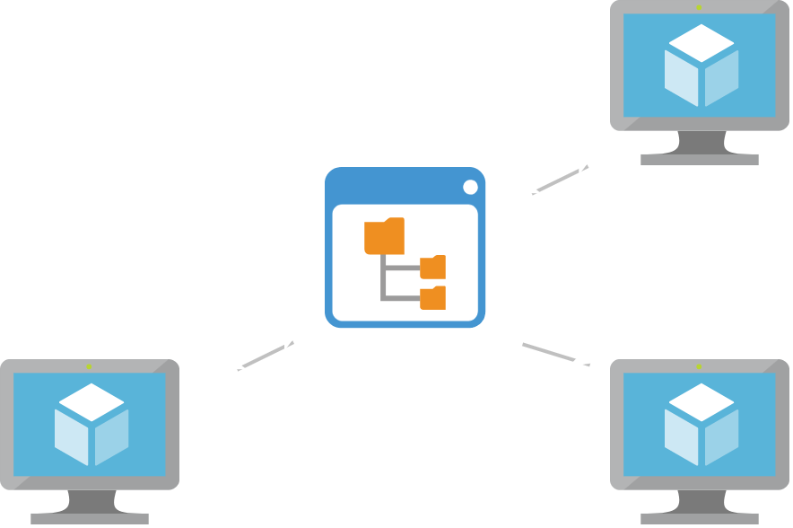
Azure File Storage
File storage with backups of databases
File storage is way cheaper than VM storage
For multiple VMs, you can have one central storage
Is mappable in VM as a network drive.
Notes:
Azure File Store as mapped drives

Slide 16
security 🔐

Slide 17

RDP over Internet is risky!
RDP over internet should always encrypted
Also refer to: microsoft.com/security/blog/2020/04/16/security-guidance-remote-desktop-adoption
Info about Azure Bastions security guideline: docs.microsoft.com/en-us/security/benchmark/azure/baselines/bastion-security-baseline
Notes:
Prone to port scans and potential DDOS risks
microsoft.com/security/blog/2020/04/16/security-guidance-remote-desktop-adoption/

Slide 18

Azure Bastion for security 🔐
Azure Bastion is easy to set up
Managed by Microsoft – Security as a Service
Works with a browser, RDP gets tunneled with SSL
Public IP address is not exposed
Alternative: End-to-End VPN from Azure to Company is possible, but not easy
sichers
Notes:
The Bastion host is deployed in the virtual network that contains the AzureBastionSubnet subnet that has a minimum /27 prefix.
The user connects to the Azure portal using any HTML5 browser.
The user selects the virtual machine to connect to.
With a single click, the RDP/SSH session opens in the browser.
No public IP is required on the Azure VM.

Slide 19
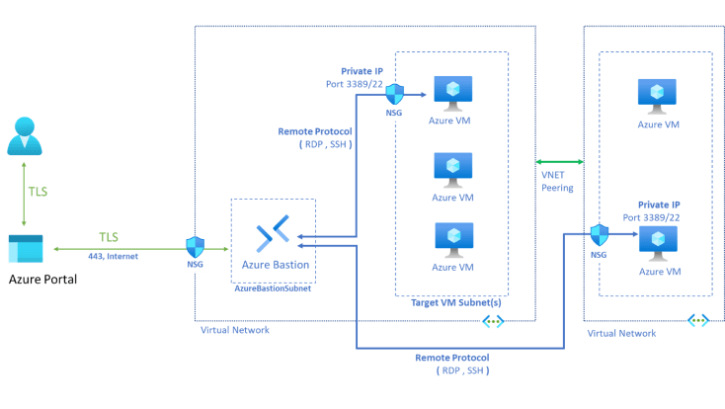
Architecture Azure Bastion
Diagram source: azure.microsoft.com/en-us/services/azure-bastion
Notes:
Architecture for Azure Bastion.
NSG = Network Security Group
Source: azure.microsoft.com/en-us/services/azure-bastion

Slide 20
Code & tools 👩‍💻👨‍💻

Slide 21
Code is ~100 lines long
Deployment takes ~1 hour
Demoing main points
Demoing browsing objects

Slide 22
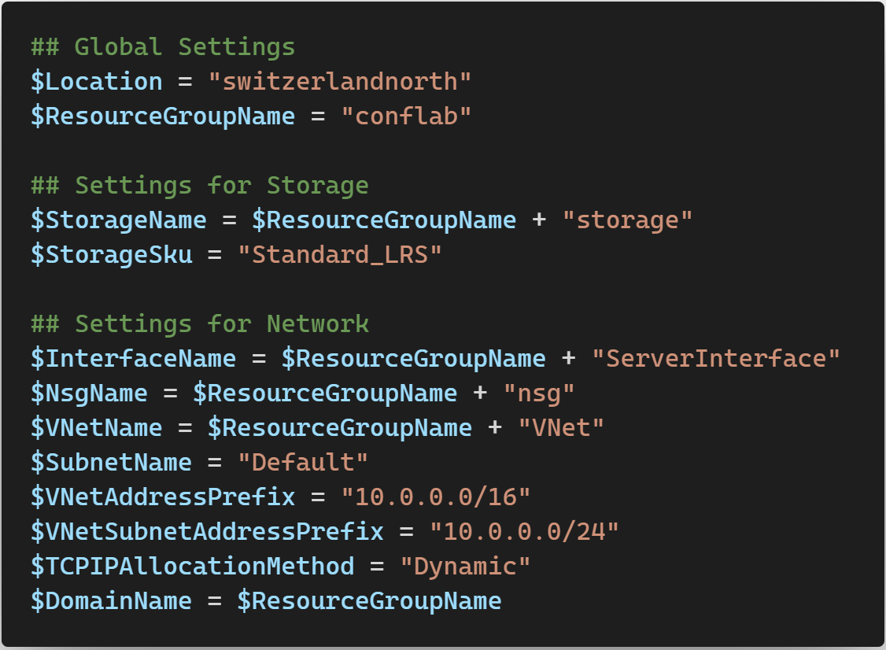

Slide 25
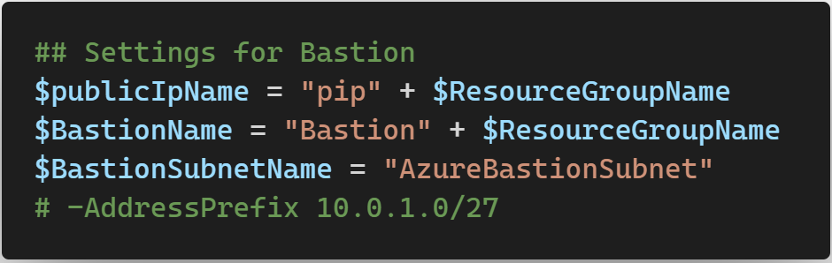

Slide 26
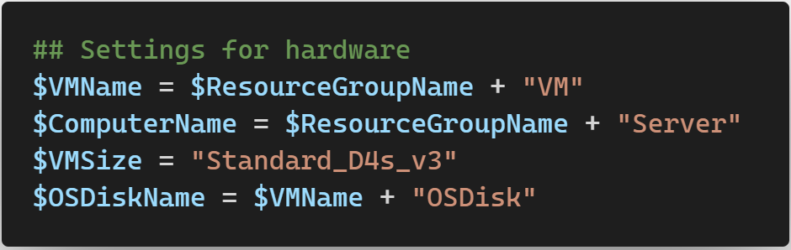

Slide 27
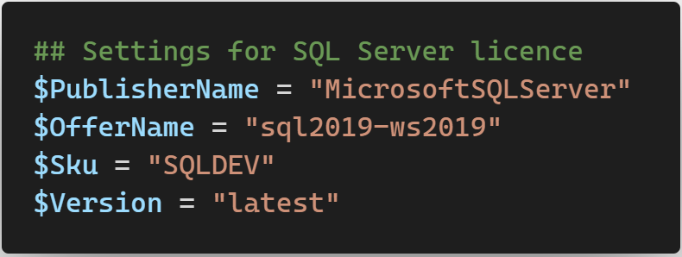
Notes:
This is the VM provided by Microsoft
SQLDEV means it is the SQL Server DEV Edition which is licensed for non production purposes
Version → latest Version refers to the latest version of it

Slide 28
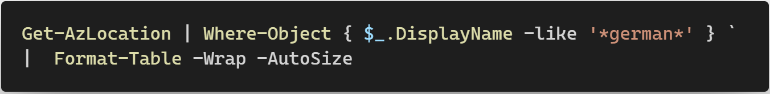
Notes:
Going to show you how you can adapt the code for yourself

Slide 29
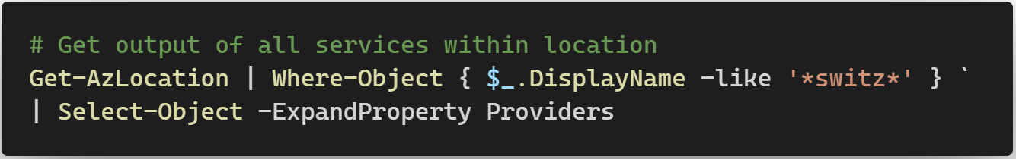
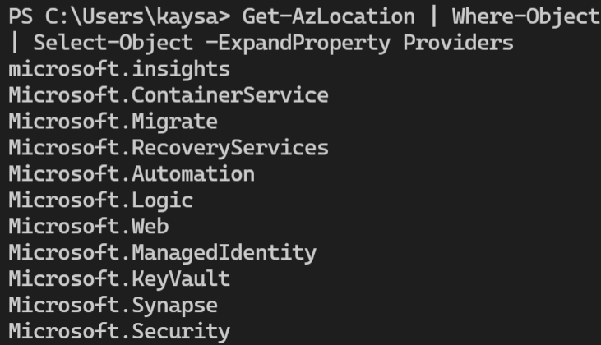

Slide 30
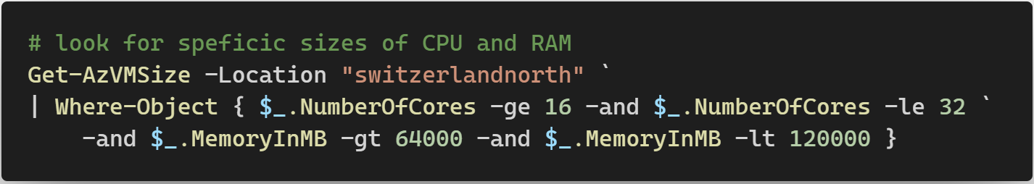
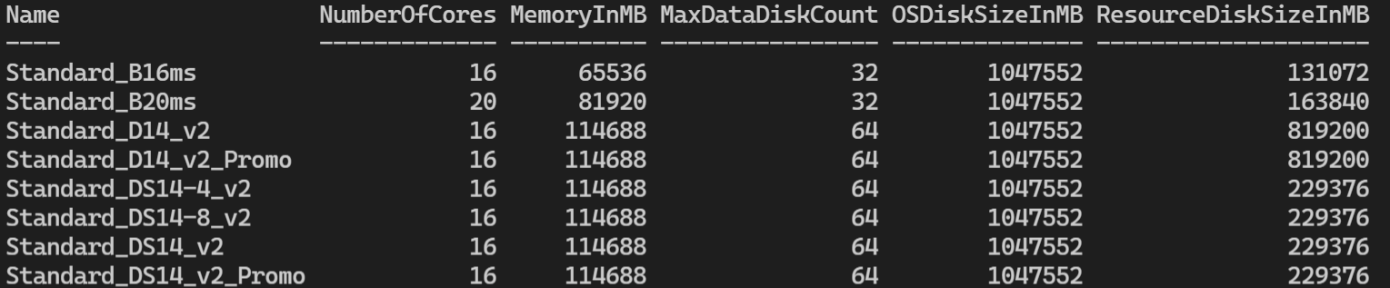

Slide 31
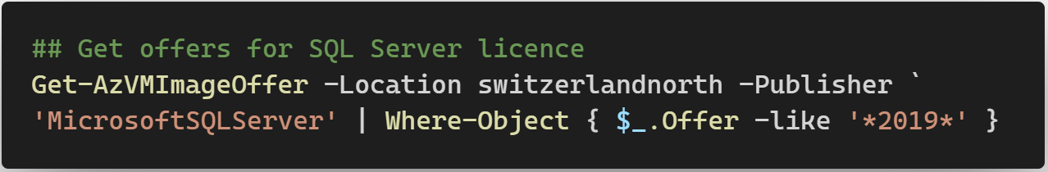
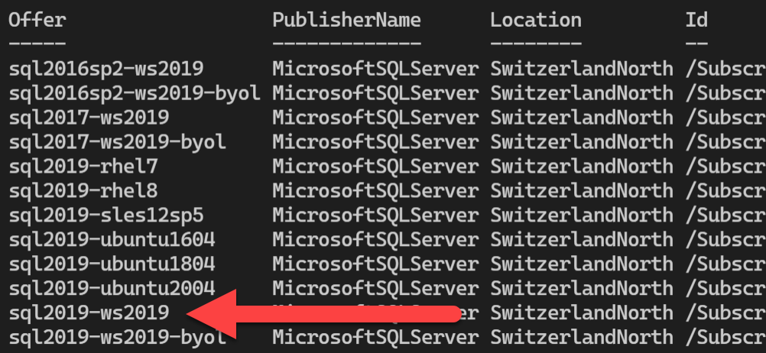

Slide 32
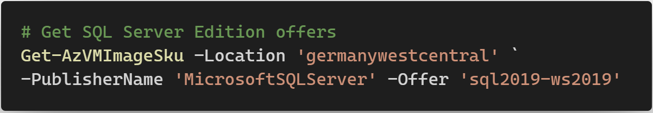
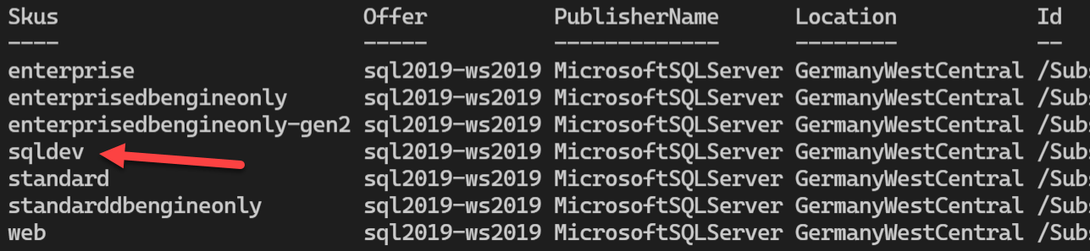

Slide 33
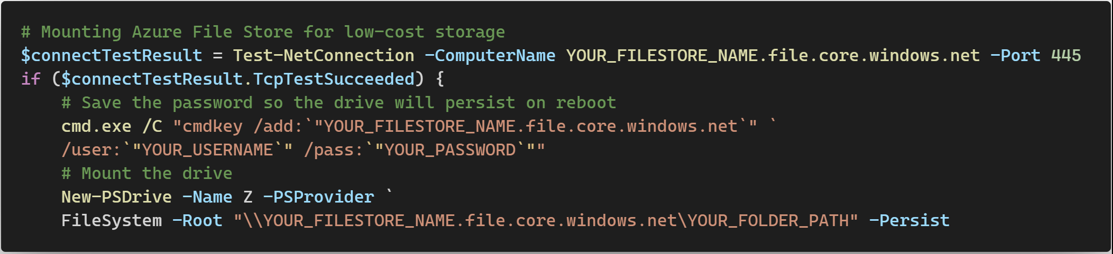
Mapping Network-drive 💾
Notes:
For more information see docs.chocolatey.org/en-us/information/security

Slide 34

Chocolatey
Bases on PowerShell
Opensource & free
Can download and install software automatically
Huge library of software
Is secure: checksums ℹ docs.chocolatey.org/en-us/information/security
Notes:
For more information see docs.chocolatey.org/en-us/information/security

Slide 35
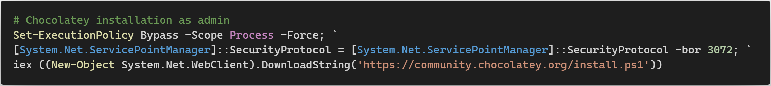
Install Chocolatey
ℹ more info & other install possibilities:
chocolatey.org/install
Notes:
Logo & Link

Slide 36
Code Samples
Use Chocolatey as admin in Terminal: choco install <Name1> <Name2>… -y
Notes:
Logo & Link

Slide 37
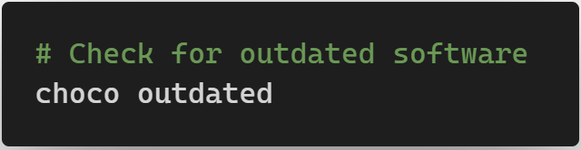
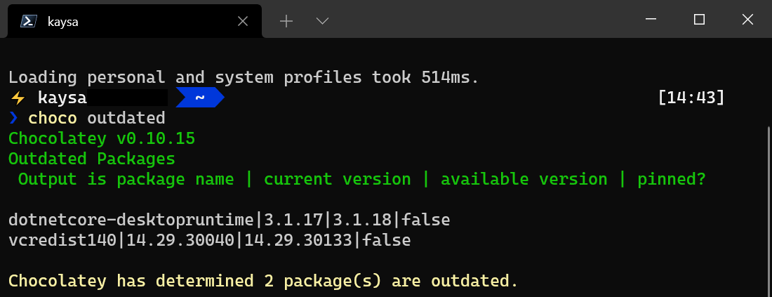
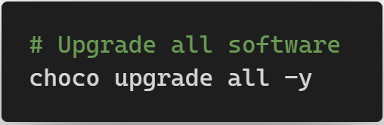
Upgrading is easy
Notes:
Logo & Link

Slide 38
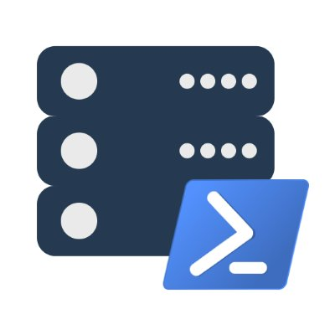
dbatools
«SSMS via PowerShell»
Open Source and free, code on GitHub
Created by Chrissy LeMaire (@cl) maintained by her
with Jess Pomfret (@jpomfret) & Shawn Melton (@wsmelton)
Very powerful and easy to use
Notes:
Logo & link

Slide 39
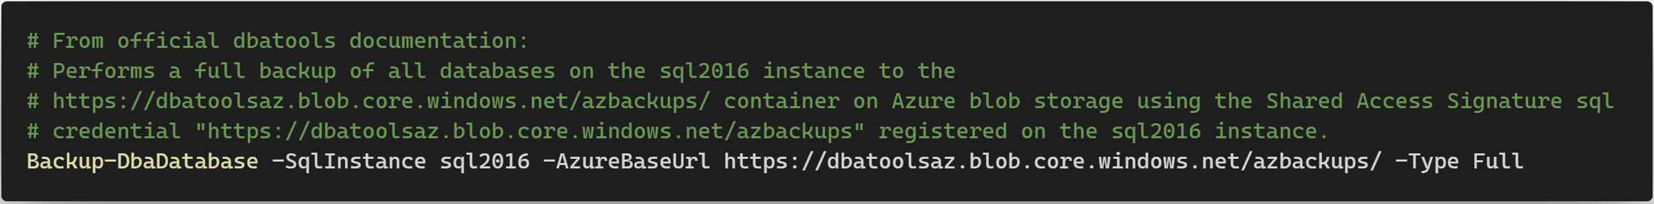
dbatools
Code sample:
Notes:
Logo & link

Slide 40
Automation On / Off VM
It is possible to tell Azure to power off a VM at a given time
You can save money that way
It is also possible to start a VM on given days/time

Slide 41
Backup & restore
Backup of VMs is possible
Backup for securing data
Restore is takes a few mins
Can be done in PowerShell

Slide 42
Pricing 💶
Rather complex
Pricing types:
Pay as you go
Reserved Virtual Machine Instances
Spot pricing
BYOL: Bring Your Own License
Also depends on
Hardware pick
Scaling up / scaling down a VM changes pricing accordingly
Software licenses

Slide 43
Series | Use case recommendation by Microsoft as perAug 18 2021 |  | Starts at USD/month
A | Entry Level | dev & test env (small - medium dbs) & PoC, Code repos | 26.28
Bs |  | dev & test env, micro services, PoC, small DB, build servers | 2.74
D 👈 | General purpose | RDBMs, Apps, in-memory caching, Analytics | 41.61
E | In-Memory Hyper-Threading | Heavy in-memory apps SSAS, SAP Hana | 58.40
F | CPU optimized | Analytics, batch processing, gaming | 35.77
G | Memory & storage optimized | DWH solutions, NoSQL, ERP | 320.47
H | High performance computing | risk analysis, weather modeling, fluid dynamics | 581.08
Ls | Storage optimized | DWH Solutions, NoSQL, Large RDBMs | 455.52
M Mv2 | Extreme parallel power | High performance DWH & Analytics M : up to 4 TB RAM and 128 vCPU Mv2: up to 12TB RAM and 416 vCPU | 1,121.65 16,286.30
N - GPU | GPU Workloads | DeepL, GPU, Video rendering, gaming | 657
source: azure.microsoft.com/en-us/pricing/details/virtual-machines/series/
Notes:
Microsofts HW-Catalogue

Slide 44
Pricing 💶
Pay-as-you-go
The standard
Pay only what and when you use
Very easy, can be cheapest if used only momentarily
Most expensive option if always used
A resource deleted = not paying anymore
Notes:
Pricing types

Slide 45
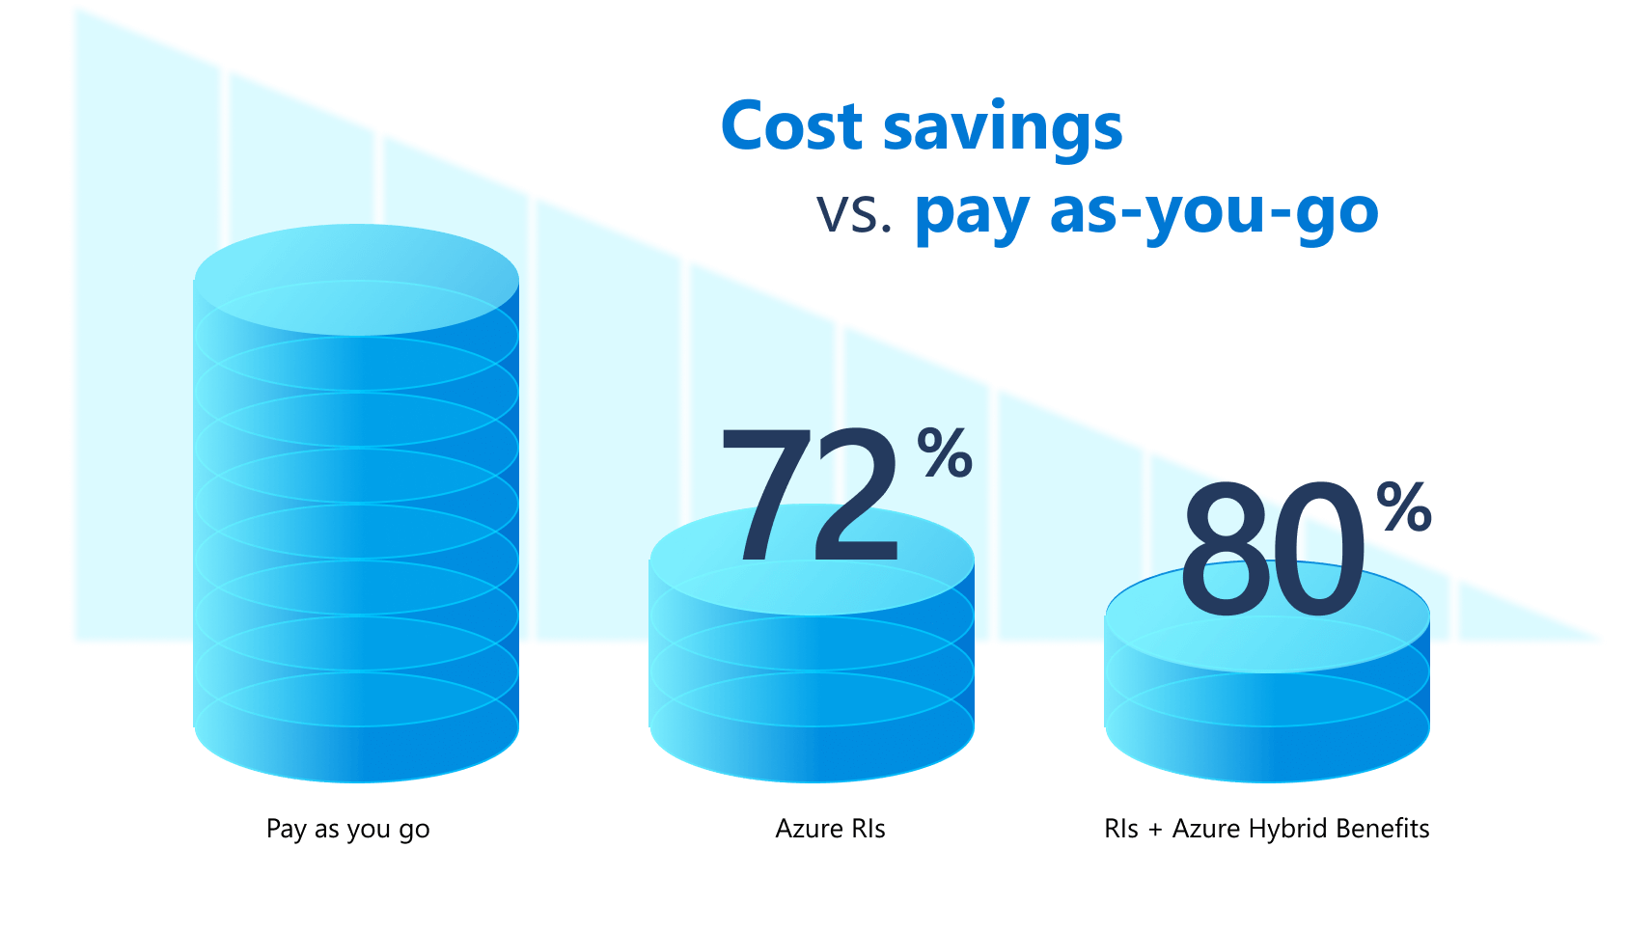
Pricing 💶
Reserved Virtual Machine Instances
Pay for longer term «hosting»
You reserve a spaced resource for you
Up to 72% cheaper
With Azure Hybrid up to 80%
Source & illustration: azure.microsoft.com/en-us/services/virtual-machines

Slide 46
Pricing 💶
Spot pricing
For failure-tolerant usecases
You can live with sudden shutdowns
Around 90% less cost
Ideal for students, «playing around» as a dev
Can be used for PRD but rather limited use cases
Source: azure.microsoft.com/en-us/services/virtual-machines/spot

Slide 47


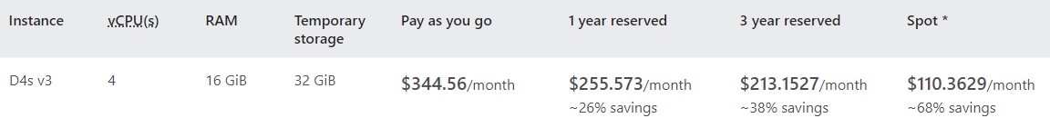
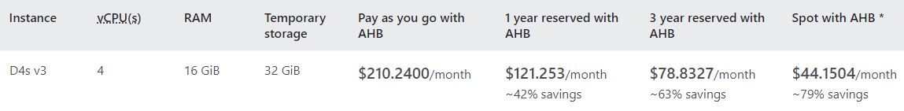

Pricing as per Aug 18 2021 azure.microsoft.com/en-us/pricing/details/virtual-machines/windows/

Slide 48
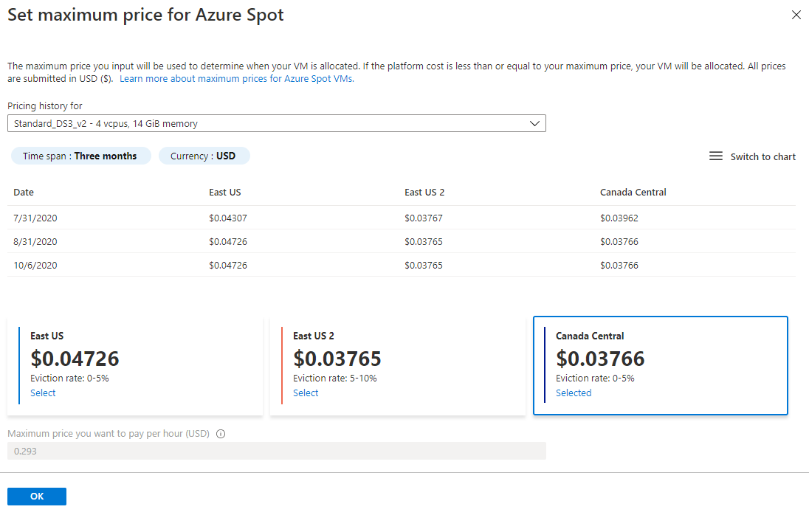
Pricing 💶
Source: docs.microsoft.com/en-us/azure/virtual-machines/spot-vms#pricing
Notes:
For spot pricing, you also can set a max price you may want to pay. If the price is over this price, Microsoft may evict your resources until the price reaches a lower price again

Slide 49
Pricing 💶
BYOL: Bring Your Own License
May be useful if you’ve got a license you bought but don’t use
Save up to 80%
Notes:
Pictures & split in more slides

Slide 50
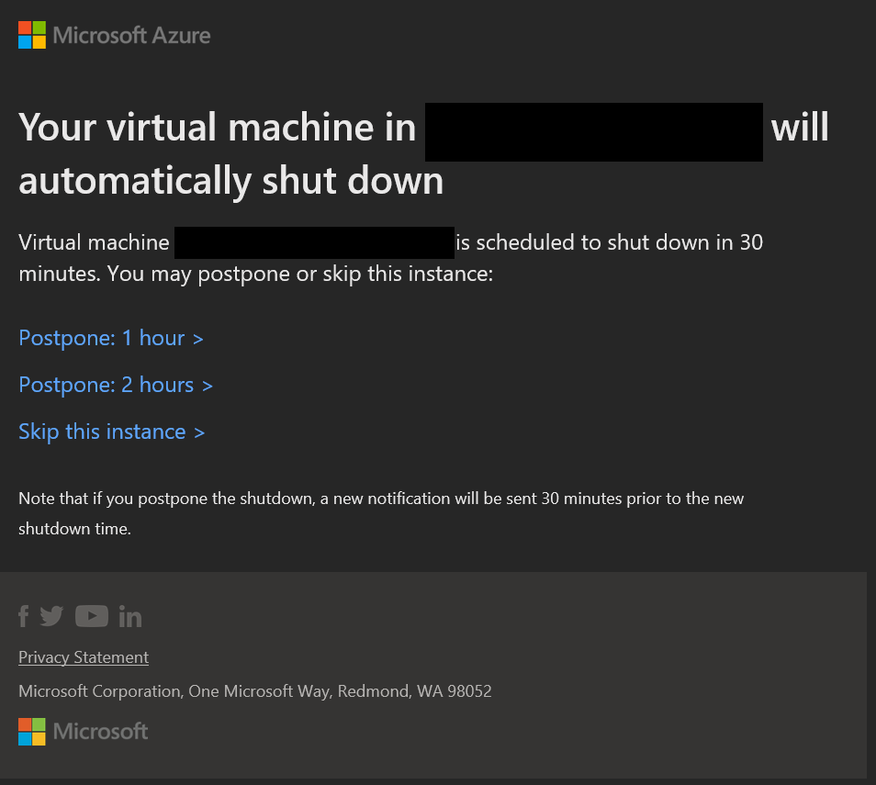
Pricing 💶
If a VM is shut down, it costs less because no CPU / RAM used
You can automate shut-downs, eg. 19:00 with email warnings with possiblity to postpone
Notes:
Pictures & split in more slides

Slide 51
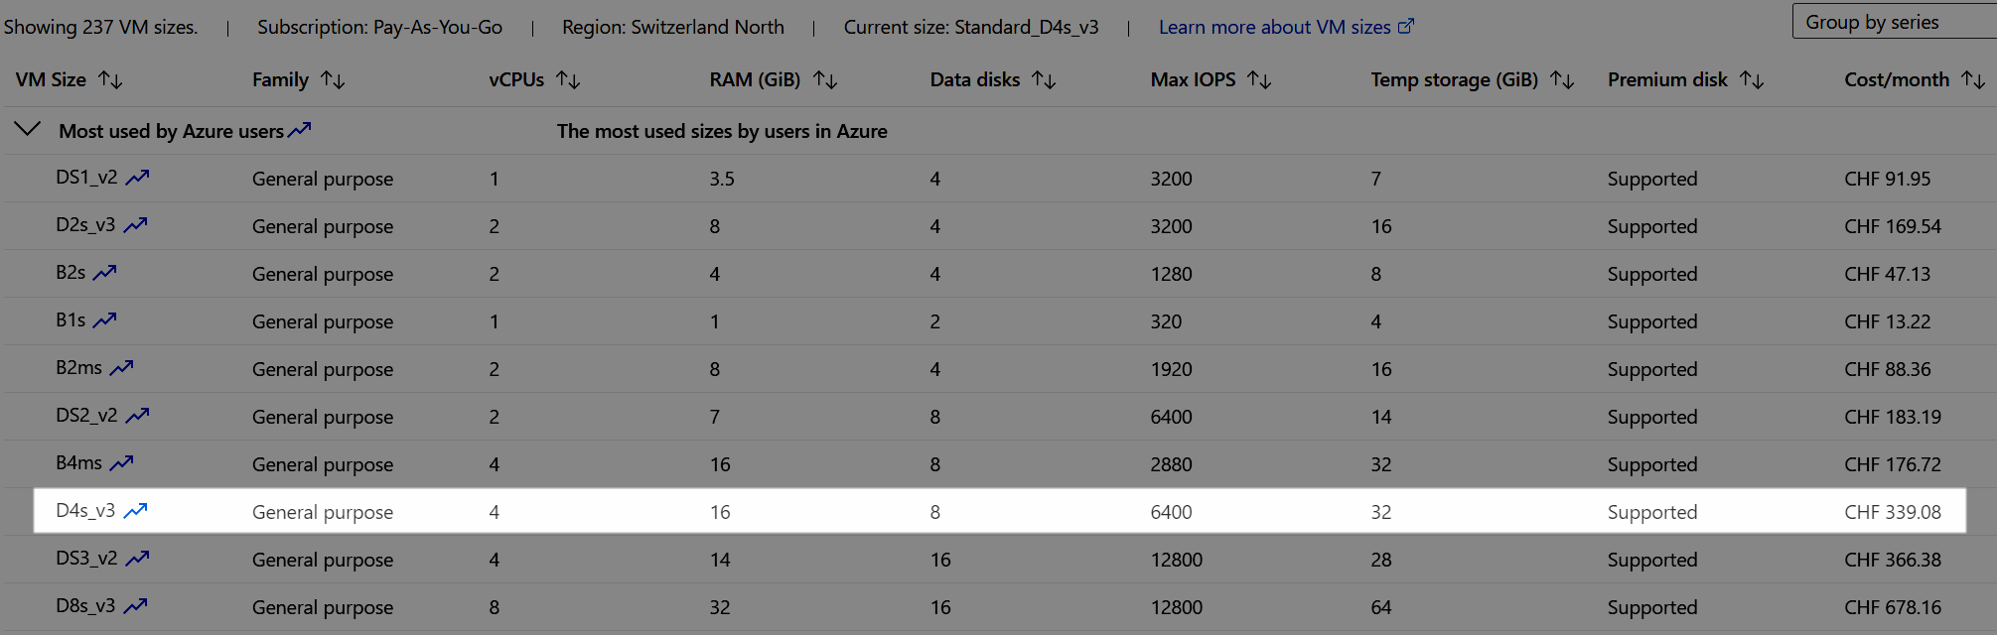
Pricing Example 💵
File store size: 5 TB
Notes:
Microsoft has a catalog of different VMs you can choose from
They differ in their hardware builds, for example better or weaker CPU / RAM / Harddisk options
The more Ram / CPU you need, the expensive it gets

Slide 52
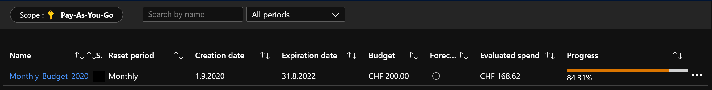
Pricing 💶
Cost management
Define a monthly budget
Notes:
Pictures & split in more slides

Slide 53
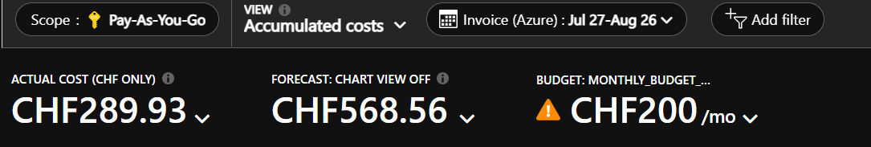
Pricing 💶
Cost management
Forecasts by Azure – works pretty well and assumes a worst-case-scenario
Notes:
Pictures & split in more slides

Slide 54
Real Example Month April for a D4s_v3
Cost breakdown in USD, total $164
Notes:
Use case @ OneDigit AG
Cost total 138 Eur

Slide 55
Recap
Almost fully automated provisoning only with PowerShell of VMs with SQL Server and restored databases is possible
Solution uses an approach from desktop via PowerShell
Chocolatey and dbatools are great helpers

Slide 56



Questions? 💬
Blog kayondata.com | onedigit.ch
@kaysauter
kay@kayondata.com | kay.sauter@onedigit.ch
linkedin.com/in/kaysauter
Data TGIF: meetup.com/en-US/data-tgif
github.com/kaysauter/Sessions
Code will be on github
Notes:
If you have any questions after the presentation, feel free to contact me through one of those channels

Slide 57




Special Thanks To
for supporting
DataPlatformGeeks & SQLServerGeeks
Community Initiatives

Slide 58

Thank You
Three Ways to Win Prizes
Post your selfie with hash tag #DPS2021
Give Session & Conference Feedback
Visit our Sponsors & Exhibitors
Follow us on Twitter @TheDataGeeks @DataAISummit

Slide 59
Heading Styling
Heading One Style, 28pt
Body content, 20pt Segoe UI (gray)
Heading Two Style, 24pt
Body content, 20pt Segoe UI (gray)
HEADING THREE STYLE, 22PT, BOLD, ALL CAPS
Body content, 20pt Segoe UI (gray)

Slide 60
Section Divider
Type 1 -

Slide 61
Section Divider
Type 2 -

Slide 62
Chart Type 1

Slide 63
Chart Type 2

Slide 64
Table
Heading 1 | Heading 2 | Heading 3 | Heading 4 | Heading 5 | Heading 6

Slide 65
Slide for Showing Developer’s Software Code
Use this layout to show software code
The font is Consolas, a monospace font
The slide doesn’t use bullets but levels can be indented using the “Increase List Level” icon on the Home menu

Slide 66
Video Title
Add subtitle

Slide 67
Demo Title
Name
Title
Group

